Slide 1
Computer Organization and Architecture

Slide 2
Introduction to Computer Organization
Computer architecture refers to those attributes of a system visible to a programmer or, put another way, those attributes that have a direct impact on the logical execution of a program.
Computer organization refers to the operational units and their interconnections that realize the architectural specifications.
Notes:
For example, it is an architectural design issue whether a computer will have a multiply instruction. It is an organizational issue whether that instruction will be implemented by a special multiply unit or by a mechanism that makes repeated use of the add unit of the system.

Slide 3
At each level, the designer is concerned with structure and function:
• Structure: The way in which the components are interrelated
• Function: The operation of each individual component as part of the structure

Slide 4
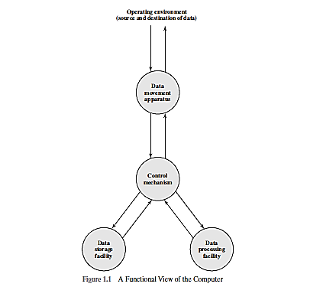

Slide 5
Function Both the structure and functioning of a computer are, in essence, simple. Figure 1.1 depicts the basic functions that a computer can perform.
In general terms, there are only four:
• Data processing
• Data storage
• Data movement : peripheral devices, data communication, I/O
• Control: computer’s resources and orchestrates the performance of its functional parts

Slide 6
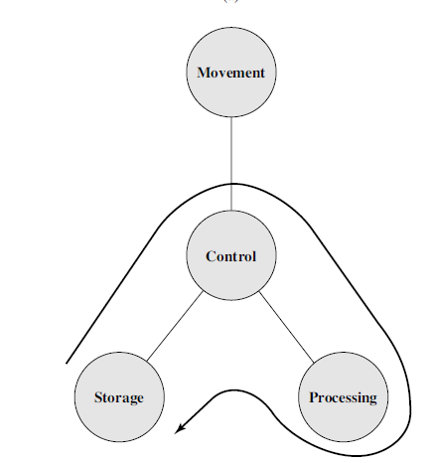

Slide 7
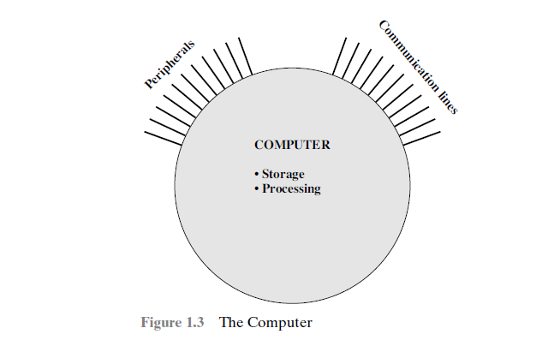
structure

Slide 8
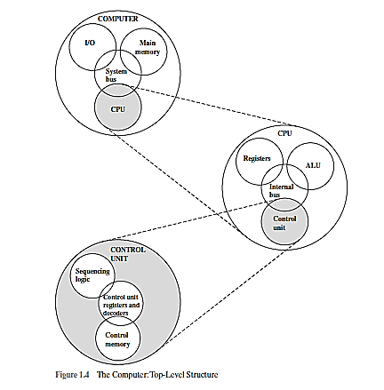

Slide 9
There are four main structural components:
• Central processing unit (CPU): Controls the operation of the computer and
performs its data processing functions; often simply referred to as processor.
• Main memory: Stores data.
• I/O: Moves data between the computer and its external environment.
• System interconnection: Some mechanism that provides for communication among CPU, main memory, and I/O.

Slide 10
system bus, consisting of a number of connecting wires to which all the other components attach.
the most complex component is the CPU. Its major structural components are as follows:
• Control unit: Controls the operation of the CPU and hence the computer
• Arithmetic and logic unit (ALU): Performs the computer’s data processing
functions
• Registers: Provides storage internal to the CPU
• CPU interconnection: Some mechanism that provides for communication
mong the control unit, ALU, and registers

Slide 11
A Brief History of Computers
The evolution of computers has been characterized by
increasing processor speed,
decreasing component size,
increasing memory size,
and increasing I/O capacity and speed.

Slide 12
One factor responsible for the great increase in processor speed is the
shrinking size of microprocessor components; this reduces the distance between components and hence increases speed.
A critical issue in computer system design is balancing the performance of the various elements so that gains in performance in one area are not handicapped by a lag in other areas.

Slide 13
The First Generation: Vacuum Tubes
ENIAC The ENIAC (Electronic Numerical Integrator And Computer), designed and constructed at the University of Pennsylvania, was the world’s first general-purpose electronic digital computer.

Slide 14
The major drawback of the ENIAC was that it had to be programmed manually by setting
switches and plugging and unplugging cables.
von Neumann and his colleagues began the design of a new stored program computer, referred to as the IAS computer, at the Princeton Institute for Advanced Studies.

Slide 15
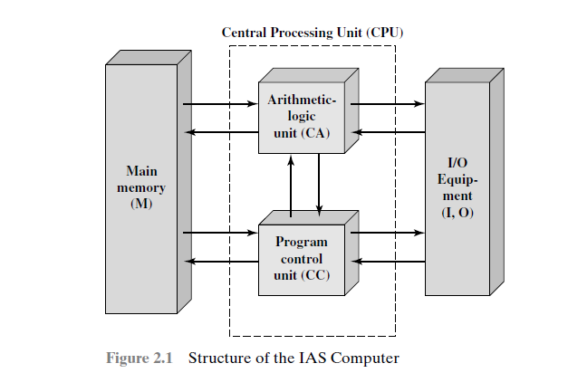

Slide 16
The Second Generation: Transistors
solid-state device, made from silicon.
The second generation saw the introduction of more complex arithmetic and logic units and control units, the use of high level
programming languages, and the provision of system software with the computer.

Slide 17
The Third Generation: Integrated Circuits
A single, self-contained transistor is called a discrete component.

Slide 18
Microprocessor: all the components of the CPU on the single chip

Slide 19
Fourth and fifth generation

Slide 20
PERFORMANCE ASSESSMENT
Clock Speed and Instructions per Second:
clock signals are generated by a quartz crystal, which generates a constant signal wave while power is applied. This wave is converted into a digital voltage pulse stream that is provided in a constant flow to the processor. For example, a 1-GHz processor receives 1 billion pulses per second. The rate of pulses is known as the clock rate, or clock speed.

Slide 21
INSTRUCTION EXECUTION RATE
MIPS and MFLOPS

Slide 22
DESIGNING FOR PERFORMANCE
Microprocessor Speed:
pipelining
Branch prediction:
Data flow analysis:
Speculative execution:
Performance Balance:

Slide 23
Improvements in Chip Organization and Architecture
There are three approaches to achieving increased processor speed:
Increase the hardware speed of the processor:
With gates closer together, the propagation time for signals is significantly reduced, enabling a speeding up of the processor.
An increase in clock rate means that individual operations are executed more rapidly.

Slide 24
Improvements in Chip Organization and Architecture
Increase the size and speed of caches that are interposed between the processor and main memory:
In particular, by dedicating a portion of the processor chip itself to the cache, cache access times drop significantly.
Make changes to the processor organization and architecture that increase the effective speed of instruction execution: Typically, this involves using parallelism in one form or another.

Slide 25
Improvements in Chip Organization and Architecture
as clock speed and logic density increase, a number of obstacles become more significant
Power: As the density of logic and the clock speed on a chip increase, so does the power density (Watts/cm2). The difficulty of dissipating the heat generated on high-density, high-speed chips is becoming a serious design issue.
RC delay: The speed at which electrons can flow on a chip between transistors is limited by the resistance and capacitance of the metal wires connecting them; specifically, delay increases as the RC product increases. As components on the chip decrease in size, the wire interconnects become thinner, increasing resistance. Also, the wires are closer together, increasing capacitance.

Slide 26
Improvements in Chip Organization and Architecture
as clock speed and logic density increase, a number of obstacles become more significant
Memory latency and throughput: Memory access speed (latency) and transfer speed (throughput) lag processor speeds.

Slide 27
Multicore, Mics, and GPGPUs
Multicore: placing multiple processors on the same chip, with a large shared cache.
Studies indicate that, within a processor, the increase in performance is roughly proportional to the square root of the increase in complexity.
But if the software can support the effective use of multiple processors, then doubling the number of processors almost doubles performance.
Thus, the strategy is to use two simpler processors on the chip rather than one more complex processor.
the power consumption of memory logic on a chip is much less than that of processing logic.

Slide 28
Multicore, Mics, and GPGPUs
As the caches became larger, it made performance sense to create two and then three levels of cache on a chip, with initially, the first-level cache dedicated to an individual processor and levels two and three being shared by all the processors.
It is now common for the second-level cache to also be private to each core.
many integrated core (MIC): more than 50 cores per chip.
The multicore and MIC strategy involves a homogeneous collection of general purpose processors on a single chip.

Slide 29
Multicore, Mics, and GPGPUs
GPUs perform parallel operations on multiple sets of data, they are increasingly being used as vector processors for a variety of applications that require repetitive computations.

Slide 30
multicore computer structure
Central processing unit (CPU): That portion of a computer that fetches and executes instructions. It consists of an ALU, a control unit, and registers. In a system with a single processing unit, it is often simply referred to as a processor.
Core: An individual processing unit on a processor chip. A core may be equivalent in functionality to a CPU on a single-CPU system. Other specialized processing units, such as one optimized for vector and matrix operations, are also referred to as cores.
Processor: A physical piece of silicon containing one or more cores. The processor is the computer component that interprets and executes instructions. If a processor contains multiple cores, it is referred to as a multicore processor.

Slide 31
multicore computer structure
A printed circuit board (PCB) is a rigid, flat board that holds and interconnects chips and other electronic components. The board is made of layers, typically two to ten, that interconnect components via copper pathways that are etched into the board.
The main printed circuit board in a computer is called a system board or motherboard, while smaller ones that plug into the slots in the main board are called expansion boards.
A chip is a single piece of semiconducting material, typically silicon, upon which electronic circuits and logic gates are fabricated. The resulting product is referred to as an integrated circuit.

Slide 32
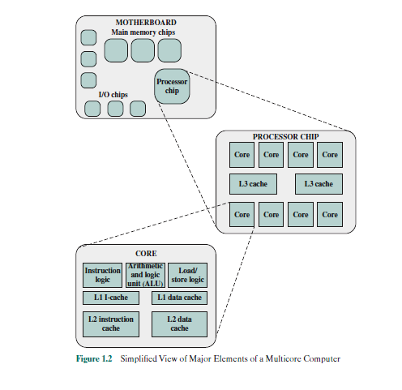
multicore computer structure

Slide 33
Amdahl’s Law
Example:

Slide 34
Little’s Law
we have a steady state system to which items arrive at an average rate of λ items per unit time. The items stay in the system an average of W units of time. Finally, there is an average of L units in the system at any one time. Little’s Law relates these three variables as
L = λ W.
The server in this model can represent anything that performs some function or service for a collection of items.
Since items arrive at a rate of λ, we can reason that in the time w, a total of λ W items must have arrived. Thus w = λ W.
To summarize, under steady state conditions, the average number of items in a queuing system equals the average rate at which items arrive multiplied by the average time that an item spends in the system.

Slide 35
Little’s Law
Example:
Consider a multicore system, with each core supporting multiple threads of execution. At some level, the cores share a common memory. The cores share a common main memory and typically share a common cache memory as well.

Slide 36
Little’s Law
Example:
If the system is being used as a server, an analyst can determine the demand on the system in terms of the rate of user requests, and then translate that into the rate of requests for data from the threads generated to respond to an individual user request.

Slide 37
Little’s Law
Example:
For this purpose, each user request is broken down into subtasks that are implemented as threads.
We then have λ = the average rate of total thread processing required after all members’ requests have been broken down into whatever detailed subtasks are required.
Define L as the average number of stopped threads waiting during some relevant time.
Then W = average response time.
This simple model can serve as a guide to designers as to whether user requirements are being met and, if not, provide a quantitative measure of the amount of improvement needed.

Slide 38
Basic Measures of Computer Performance
Clock speed
Instruction execution mode

Slide 39



Example on CPI and MIPS

Slide 40
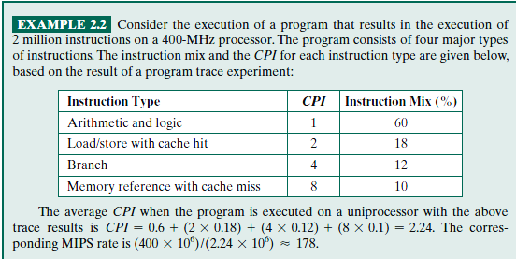
Example on CPI and MIPS

Slide 41
Top level view of computer function and evolution
a computer system by
(1) describing the external behaviour of each component—that is, the data and control signals that it exchanges with other components;
(2) describing the interconnection structure and the controls required to manage the use of the interconnection structure.

Slide 42
Computer components
von Neumann architecture and is based on three key concepts:
Data and instructions are stored in a single read–write memory.
• The contents of this memory are addressable by location, without regard to the type of data contained there.
• Execution occurs in a sequential fashion (unless explicitly modified) from one instruction to the next.

Slide 44
Computer function

Slide 45
Basic instruction cycle

Slide 46
The fetched instruction is loaded into a register in the processor known as the instruction register (IR). The instruction contains bits that specify the action the processor is to take. The processor interprets the instruction and performs the required action. In general, these actions fall into four categories:
• Processor-memory: Data may be transferred from processor to memory or
from memory to processor.
• Processor-I/O: Data may be transferred to or from a peripheral device by transferring between the processor and an I/O module.
• Data processing: The processor may perform some arithmetic or logic operation on data.
• Control: An instruction may specify that the sequence of execution be altered. For example, the processor may fetch an instruction from location 149, which specifies that the next instruction be from location 182. The processor will remember this fact by setting the program counter to 182.

Slide 48
Interrupts

Slide 49
Interrupts
communication between modules that results from interrupts
For example, most external devices are much slower than the processor.
Long and short IO
Multiple interrupts: disabled and ISR

Slide 52
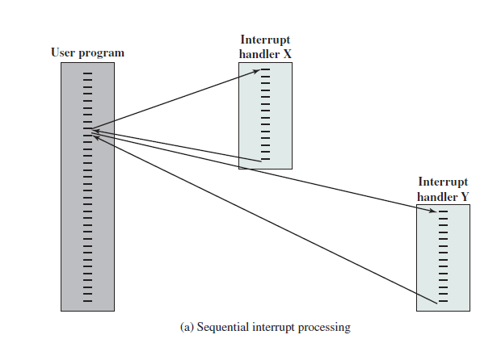

Slide 54
Interconnection structures

Slide 55
Bus interconnection: shared transmission medium
System bus
Data bus
Address bus
Control bus: both command and timing information
Point to point interconnection

Slide 57
Bus interconnection
An instruction cycle consists of an instruction fetch, followed by zero or more operand fetches, followed by zero or more operand stores, followed by an interrupt check (if interrupts are enabled).
The major computer system components (processor, main memory, I/O modules) need to be interconnected in order to exchange data and control signals: shared system bus consisting of multiple lines.
Key design elements for buses include arbitration (whether permission to send signals on bus lines is controlled centrally or in a distributed fashion): timing and width design decisions.

Slide 59
Quick Path Interconnect (QPI)

Slide 60
Point to point interconnection

Slide 61
PCI Express
The peripheral component interconnect (PCI) is a popular high-bandwidth, processor-independent bus.
PCI delivers better system performance for high-speed I/O subsystems .
e.g., graphic display adapters, network interface controllers, and disk controllers).

Slide 62
A key requirement for PCIe is high capacity to support the needs of higher data rate I/O devices, such as Gigabit Ethernet.
Another requirement deals with the need to support time-dependent data streams.
Applications such as video-on-demand and audio redistribution are putting real-time constraints on servers.

Slide 64
Thank you

Slide 65
1000 Start
1001 OP1 02H
1003 OP2 02H
1004 ADD OP1 OP2
1005 Store result OP3
1006 END

Slide 66
2000 Start
2001 OP4 01H
2003 ADD OP4 OP2
2004 Store result OP5
2005 END (Return)
1000 Start
1001 OP1 02H
OP2 02H
1004 INR 1
1005 ADD OP1 OP5
1006 Store result OP3
1007 END

Slide 67
2000 Start
2001 OP4 01H
ADD OP4 OP2
Store result OP5
INR 2
2006 END (Return)
1000 Start
1001 OP1 02H
OP2 02H
1004 INR 1
1005 ADD OP1 OP7
1006 Store result OP3
1007 END
3000 Start
3001 OP6 01H
3003 ADD OP6 OP5
3004 Store result OP7
3005 END (Return)

Slide 68
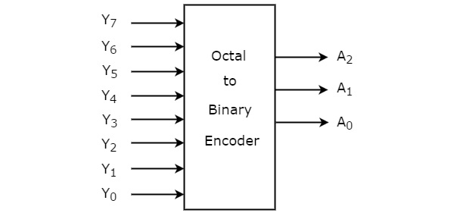
Octal to Binary Encoder

Slide 69
Truth Table
Input | A2 | A1 | A0
D0
D1
D2
D3
D4
D5
D6
D7
( 7 6 1) = ( )

